Slide 1
Artificial Intelligence in Gaming
Notes:
Hi! In this lesson we'll learn about the role that Artificial Intelligence plays in gaming.

Slide 2
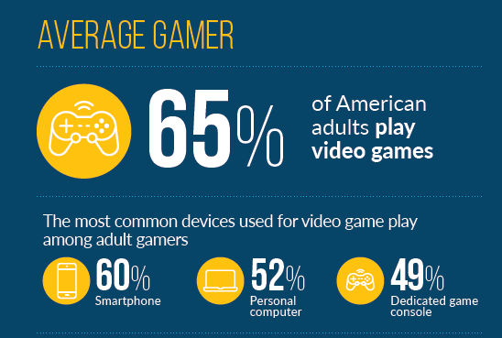
Gaming in America
Over 164 millions Americans play video games across all types of consoles!
Source: Entertainment Software Association (2019)
Notes:
As you are probably aware, gaming is an increasingly popular way for people to spend their time. In 2019, studies found that over 164 million Americans play video games of any kind. It's estimated that over 2.4 billion people worldwide play video games as well!

Slide 3

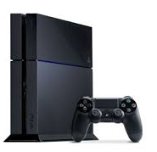
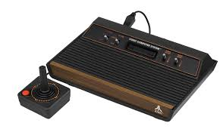

Gaming and Computer Science
Games across all consoles are built using code!
Notes:
No matter what game you or your friends are playing, chances are it was built using computer science. From the earliest gaming consoles to your current phone, games rely on computer science to create graphics, enable character movement, and control interactions between the computer and the user.

Slide 4
User - Computer Interactions
Artificial Intelligence is often used to enhance user - computer interactions.
Notes:
While AI is used in gaming in a variety of ways, this lesson and the module at large will focus on the ways that Artificial Intelligence is used to enhance computer and user interactions.

Slide 5
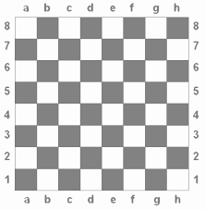












User - Computer Interactions
Artificial Intelligence is often used to enhance user - computer interactions.
Notes:
Let's consider a game of chess. If someone wanted to program a useable game of chess, it's necessary that they create a computer player that can respond to moves made by a user - otherwise the game wouldn't be very fun if you didn't have a partner to play with!

Slide 6
User - Computer Interactions
Artificial Intelligence is often used to enhance user - computer interactions.
Notes:
The most basic version of this game would be to create a computer player that randomly makes moves in response to the user. The inherent problem with this version of the game is that the computer may make illogical moves that will lead to them losing. In this example, the computer randomly decides to move it's Knight into a space where it can be taken by a pawn.
Games like these aren't fun or realistic because the object for both players is to beat the other! If one of the players isn't "programmed" to play to win, then the inherent challenge or purpose of the game isn't being realized completely.

Slide 7
AI in Gaming
The purpose of Artificial Intelligence in gaming is to create adaptive and intelligent behaviors that mimic real life human interactions and behaviors.
Notes:
AI is used in gaming to create adaptive and intelligent computer programs that behave similarly to human beings by assessing the current state of the game and making predictions about what the user might do in response to a move that they'll make.

Slide 8
Finite State Machine
Some games use a Finite State Machine (FSM) algorithm to control non-player characters (NPCs).
Notes:
The simplest implementation of this in gaming is the use of a Finite State Machine algorithm.

Slide 9
Finite State Machine
Some games use a Finite State Machine (FSM) algorithm to control non-player characters (NPCs).
A Finite State Machine generates reactions based on a pre-set list of possible interactions.
Notes:
Finite State Machines generate reactions from non-player characters, or NPCs, based on a preset list of possible interactions.

Slide 10

FSM in Action
Finite State Machines are commonly used in action games.
Notes:
These types of algorithms are commonly used in action games, where users are interacting with NPCs designed to respond to users. One of the more popular games that uses FSM systems is Assassin's Creed.

Slide 11
FSM in Action
Finite State Machines are commonly used in action games.
NPCs start in an initial state.
They remain in this state until prompted to transition.
Wander
Notes:
In assassin's creed, most NPC's start by wandering around their designated area in the game. Wandering is considered a state, or condition, of the NPC. They remain in this state until they are prompted to transition to another state.

Slide 12
FSM in Action
Finite State Machines are commonly used in action games.
Wander
Enemy in sight
Attack
Notes:
For instance, if a user becomes spotted by a wandering NPC, the NPC might transition to attack state, where the NPC is programmed to shoot, attack or engage with the user in sight.

Slide 13
FSM in Action
Finite State Machines are commonly used in action games.
Wander
Enemy in sight
Attack
Enemy escapes
Notes:
When the user escapes the line of site or moves far enough away from the NPC's designated location, the NPC may return back to its initial state and wander the map.

Slide 14
FSM in Action
Finite State Machines are commonly used in action games.
Wander
Enemy in sight
Attack
Enemy escapes
Evade
Low on health
Notes:
Alternatively, the NPC could move to the Evade state if it runs low on health.

Slide 15
FSM in Action
Finite State Machines are commonly used in action games.
Wander
Enemy in sight
Attack
Enemy escapes
Regains health
Evade
Low on health
Notes:
And then back to Wander if it regains a certain amount of health. The NPC is constantly checking its current state and its "surroundings" to determine if it should remain in its current state, or transition to another.

Slide 16
FSM in Action
There are a finite number of (predictable) responses!
Wander
Enemy in sight
Attack
Enemy escapes
Regains health
Evade
Low on health
Notes:
As the name suggests, NPCs are limited to a finite number of possible states, each that has been programmed by a game developer.
While FSM's enhance the realistic nature of games, they can often be predictable. Once a gamer recognizes the patterns that NPC's follow, it can become easy to predict how an NPC will react, making game play less realistic and prescribed.

Slide 17
Search Trees
A more sophisticated approach to emulate human behavior is the use of search tree algorithms.
Notes:
A more sophisticated approach to emulating human behavior is the use of search tree algorithms in games.

Slide 18
Search Trees
A more sophisticated approach to emulate human behavior is the use of search tree algorithms.
Search trees enable NPCs to consider all possible moves and respond optimally.
Notes:
Search Trees enable NPCs to consider all possible moves and respond optimally.

Slide 19
Search Trees
Search trees enable NPCs to consider all possible moves and respond optimally.
Notes:
Let's go back to our chess example - we don't want to play a game where the computer is making random decisions about where to go. Search trees are often used in strategy games because the computer will make decisions based on the optimal next play.

Slide 20
Search Trees
Search trees enable NPCs to consider all possible moves and respond optimally.
Notes:
Once the user makes their move,

Slide 21
Search Trees
Search trees enable NPCs to consider all possible moves and respond optimally.
The computer will search all possible moves and determine which one is best in order for the computer to win!
Notes:
The computer will search all possible moves and determine which one is best in order for the computer to win

Slide 22
Search Trees
Search trees enable NPCs to consider all possible moves and respond optimally.
The computer will search all possible moves and determine which one is best in order for the computer to win!
Notes:
Once it finds that optimal move, it will then go ahead and take their turn

Slide 23
Search Trees
Search trees enable NPCs to consider all possible moves and respond optimally.
The computer will search all possible moves and determine which one is best in order for the computer to win!
Notes:
And then wait for the user to make another move, and repeat the process over again. In contrast to FSM systems, search trees allow NPC's to anticipate what a user might do and responds after considering all of the options available.

Slide 24
Optimal ≠ Optimal for Gaming
If a computer plays optimally at all times, then it's impossible to beat the computer.
Notes:
It's important to note that finding the optimal answer is not always the best course of action. If a computer is always playing optimally, then it's impossible to beat it - It's always going to make the right move! Even if you were playing a perfect game, the end result would best be a tie.

Slide 25
Optimal ≠ Optimal for Gaming
If a computer plays optimally at all times, then it's impossible to beat the computer.
Games aren't fun if they can't be beaten! AI in gaming must be sophisticated enough to be realistic, but simple enough to be enjoyable.
Notes:
In turns out games aren't fun if they aren't beatable! As a result, AI in gaming is a bit different than in other fields, where we are always looking to optimize our results. In gaming, our algorithms need to be sophisticated enough that they appear to be realistic, but simple enough that they are enjoyable for users who are interacting with it.

Slide 26
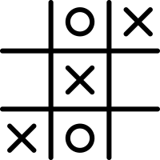
Looking Ahead
In this unit, you'll create an unbeatable AI version of Tic Tac Toe using search tree algorithms!
Notes:
In this unit, you will get a chance to build your own version of an unbeatable Tic Tac Toe game and then a beatable version of the game using search tree algorithms!

Slide 27
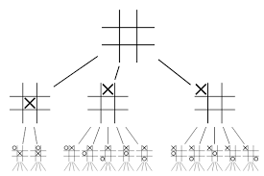
Looking Ahead
Notes:
By the end of this unit, your program will be able to search all possible Tic Tac Toe moves, and determine which is the best move for the computer!

Slide 28
Now It's Your Turn!
Notes:
Now that you've learned a bit more about AI in gaming, it's your turn to explore!

